Slide 1


Introduction to Globus for Research Data Management
Brian Roland
Data Management Specialist
Northwestern IT
Research Computing and Data Services

Slide 2
What is Globus?
Globus is a powerful data management, transfer, and collaboration tool designed to simplify research workflows and empower users to securely manage and share large amounts of data from a variety of data storage platforms.

Slide 3
What is Globus?
Globus enables users to transfer and manage data between endpoints that Globus calls Collections.
Globus transfers leverage advanced protocols that provide users with:
High performance data transfers optimized via GFTP
Automatic fault recovery and error checking
Fire and forget functionality
Encryption in transit (HTTPS)
Post-transfer file integrity verification

Slide 4
What is Globus?
Additional key features of Globus provides include:
Web based user interface
Downloadable client that enables transfers to local machine storage (Globus Connect Personal)
Automation and scheduling functionality
Data Sharing capabilities

Slide 5
Why use Globus?
Used by research institutions and government facilities across the globe.
2600+ Connected Institutions
Makes data storage usage more accessible to researchers. Allows researchers to efficiently manage usage on a variety of storage systems.
Institutional Storage
Local Storage
Commercial cloud storage platforms
Developers can use Globus to automate data workflows leveraging the Globus API, SDK, and command line tools (Advanced)

Slide 6
Globus Collections
Globus allows users to manage and transfer data between nodes they call Collections. Globus supports three types of Collections:
Mapped Collections
Guest Collections
Globus Connect Personal Collections
Notes:
A collection is a logical grouping of files and/or directories that can be managed and shared together as a single entity.
A collection can be thought of as a container for data that can be accessed, transferred, shared, and managed as a unit.

Slide 7
Mapped Collections
A Globus Mapped Collection provides access to centrally administered storage platforms.
NU IT supports Mapped Collections that provide access both on-prem and cloud-based storage systems
Notes:
Deployed by NU IT that allows authorized users access to specific NU IT supported storage platforms

Slide 8
Guest Collections
A Globus Guest Collection is a shared storage space within Globus that enables external collaborators to access specific data.
Guest Collections facilitate secure external collaboration by providing controlled access to designated data. This allows researchers to collaborate with external partners without compromising data security.
Notes:
Shared collections are hosted on either managed collections or Globus Connect Personal collections.
Shared collections are required if sharing data with external collaborators.
The owner of the shared collection defines the highest-level path that can be accessed, sets user access, and the user permissions are inherited by any subfolders.

Slide 9
Globus Connect Personal Collections
A Globus Connect Personal Collection is enabled by installing Globus Connect Personal client on a local machine.
Globus Connect Personal Collections allow for efficient transfers between local storage and other Globus endpoints.

Slide 10
Globus at Northwestern University
Use of Globus at Northwestern University can only be used with data that is not legally or contractually restricted.
No PHI, PII, HIPAA, FISMA data

Slide 11
Globus at Northwestern University
NU IT supports Globus Managed Collections that access both on-premises and cloud-based storage
On Campus
Off Campus
Quest Storage
Research Data Storage Service (RDSS)
File Storage services
Cloud Providers
Home directory
Amazon Web Service
SharePoint
Project directory
resfiles
OneDrive
Microsoft Azure
resfiles-audit
Global Scratch Space
Google Drive
Google Cloud Platform
fsmresfiles

Slide 12
Northwestern Managed Collections
Name | UUID
Northwestern Quest | d5990400-6d04-11e5-ba46-22000b92c6ec
Northwestern Quest RDSS | 8f796c9e-f5c8-11e5-9842-22000b9da45e
Northwestern AWS us-east-1 N. Virginia | bf0474ea-df2f-45f6-82e3-41d062d84ce7
Northwestern AWS us-east-2 Ohio | a14148f0-23dc-488f-affd-bd981f919b10
Northwestern AWS us-west-2 Oregon | 880cd765-5d14-43f6-97a6-2dbb355f3560
Northwestern OneDrive Pilot* | 930c2fcb-416e-4540-a757-496f86acbe70
*Provides access to both OneDrive and SharePoint

Slide 13
Globus and RDSS
Globus access to RDSS must be requested so that NU IT can configure your Globus access to specific RDSS share paths.
To submit a request for access, please submit the Request Access to RDSS via Globus Form found in the NU IT Service Catalog. In the form you will need to include the following information:
NetID
Full share path:
//resfiles.northwestern.edu/SHARENAME/
//fsmresfiles.fsm.northwestern.edu/fsmresfiles/DEPARTMENT/LAB/

Slide 14
Getting started with Globus
Use of Globus with the Northwestern Quest Mapped Collection requires a Quest account.
Globus uses your netID and Password for authentication via Northwestern’s Single Sign-On Service (SSO)
Use of Globus with RDSS requires user to complete the Request Access to RDSS via Globus form.

Slide 15
Use Case #1
Scenario: Brian Roland has to upload files from his local machine to Quest HPC to perform analysis.
Step 1: Install and configure Globus Connect Personal
Step 2: Identify the directory he needs to transfer and submit a Globus transfer task

Slide 16
Globus Connect Personal
Download Globus Connect Personal
Supports Mac, Windows, and Linux machines
During installation, the user will need to log into Globus and provide consent for Globus to access the local file system
It is recommended that a globally unique name is used for the Globus Connect Personal Collection during the installation process
Notes:
Works with firewalls that block incoming connections.
Uses proven Globus infrastructure for security and authentication.
User can define the paths locally that are made available to Globus

Slide 17
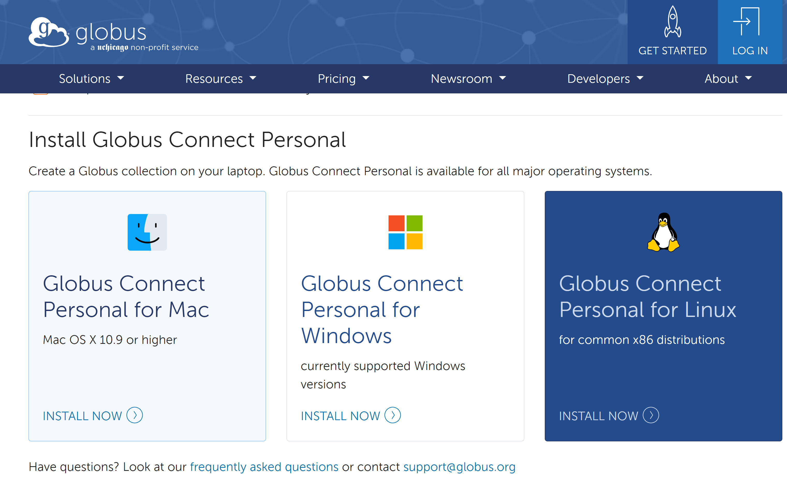
Download Globus Connect Personal
Select the OS for your local machine and click on INSTALL NOW
Follow the instructions that are provided for your OS to install the free downloadable client
After Globus Connect Personal in successfully installed, you will be prompted to log in to complete setup. Log in with your Northwestern credentials
Globus will prompt you to accept the required consents for Globus Connect Personal Setup

Slide 18
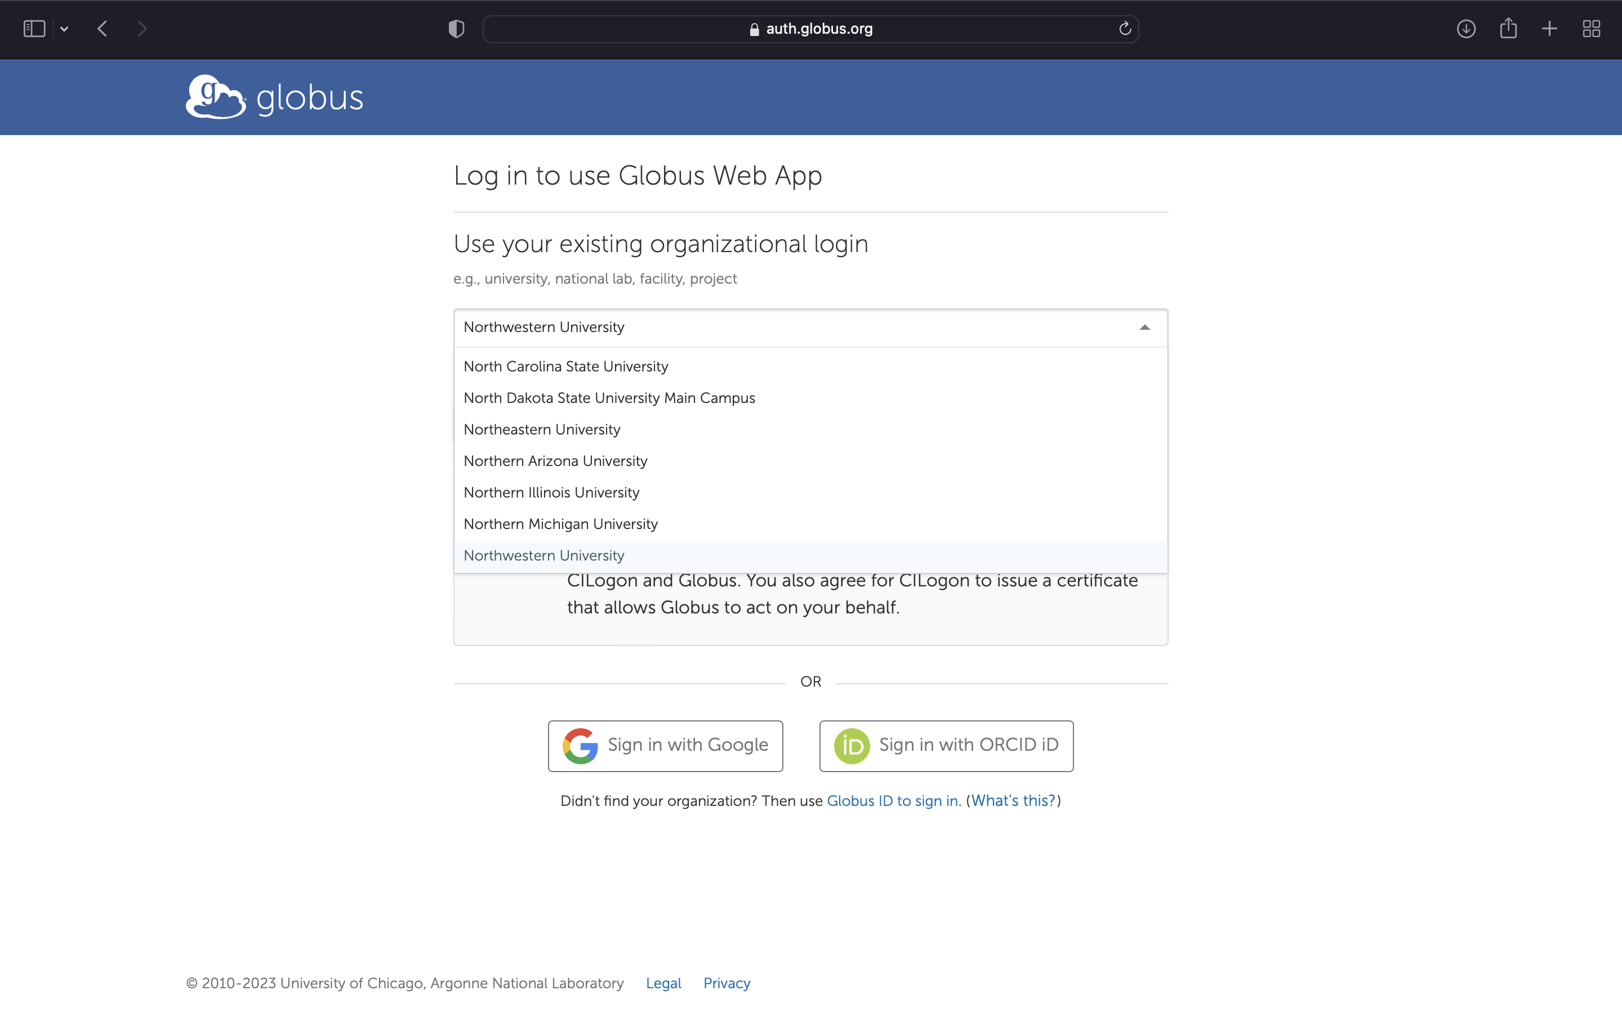
Logging in via NU Credentials

Slide 19
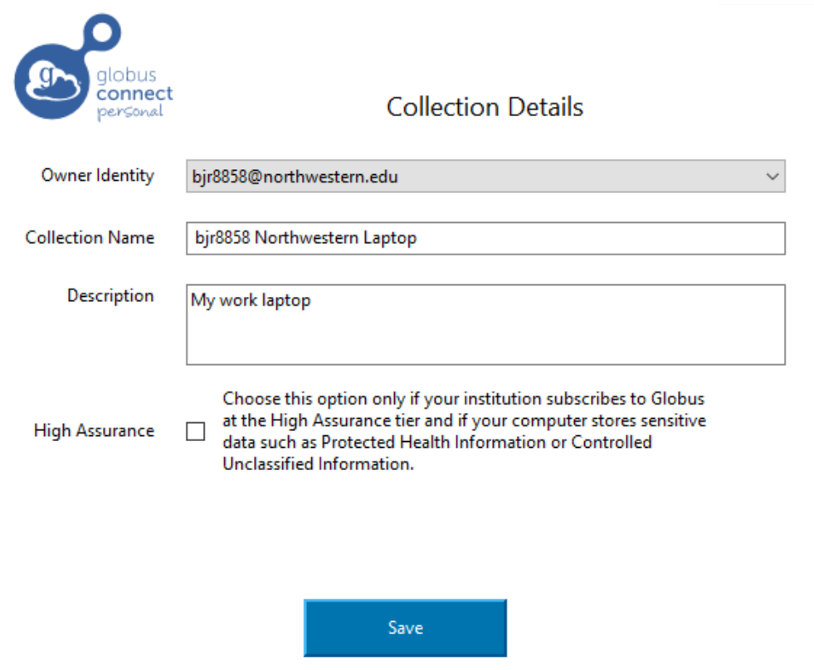
Provide Collection Details
Owner Identity: This should be your NetID@northwestern.edu so that your Globus Connect Personal Collection is affiliated with your Northwestern identity in Globus
Collection Name: A name that you can chose for your Globus Connect Personal Collection.
Description: A short description that can help describe the Collection and/or what it will be used for

Slide 20
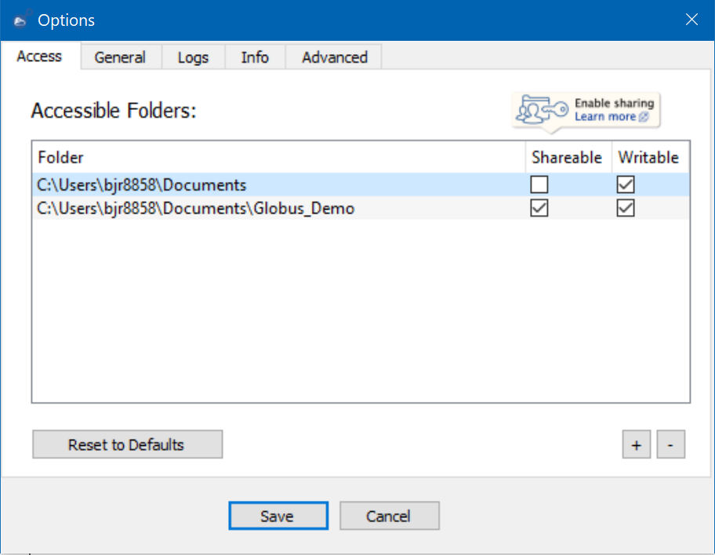
Configure Globus Connect Personal
Next you will need to configure Globus Connect Personal on your local machine to define which directories Globus can access and if sharing should be enabled for those Collection.
To Configure Globus, you will need to right-click on the icon in your system tray (PC) or the menu bar (Mac) and select Options… (PC) or Preferences (Mac)
This will bring up the Globus Connect Personal Options window

Slide 21
Add Accessible Folders
To Add folders that Globus Connect Personal can access, click on the + button in the bottom right corner of the page.
This will open a new window that will let you explore your file system and select the folder(s) that you would like to add.
There are checkboxes for Shareable and Writable that you can select for each folder
Shareable: These folders can be shared via a Globus Guest Collection that you create
Writable: This will let Globus know if it can write to the folder or only read from the folder.

Slide 22
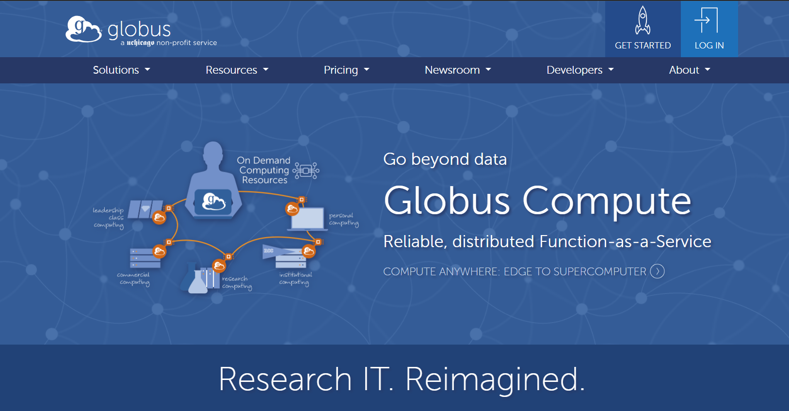
https://www.globus.org/

Slide 23
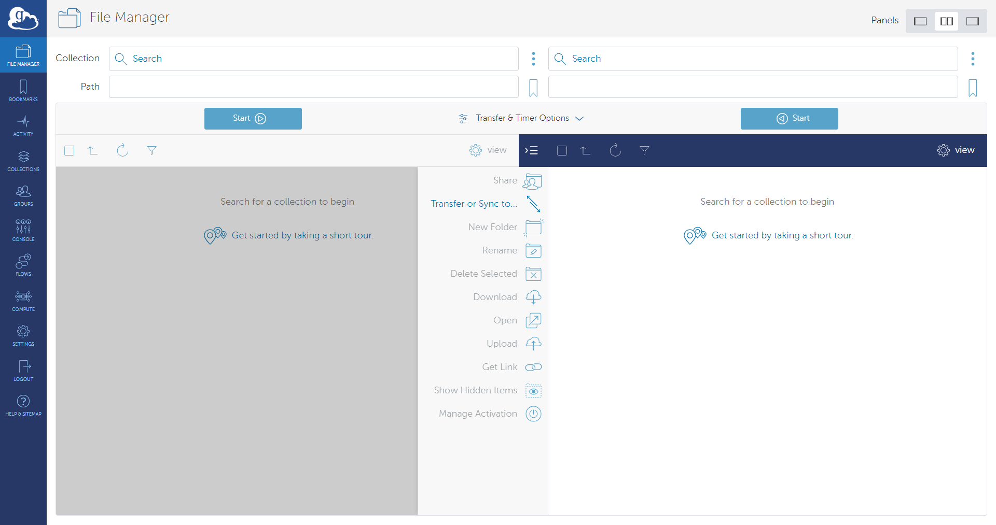
Navigation Menu
File Manager is where you will setup and submit globus transfers
Bookmarks is where you can find and manage shortcuts you to various Collections frequently accessed
Activity is where users can find the status of current transfers and a history of recently completed transfers.
Collections is where you can search information on publicly listed Globus Collections.
Groups is where users can create, manage, or request access to Globus groups that help manage permissions on Globus Collections
Settings is where users manage their Globus account including consents, Globus Group memberships, and the developer console.

Slide 24
File Manager: Setting up your transfer
Source Collection
Destination Collection

Slide 25
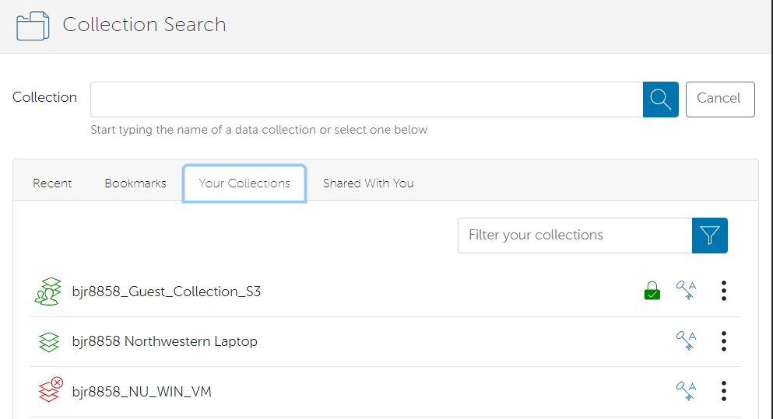
Selecting Source of Transfer
To select a Collection to serve as the data source, click in the Collection field.
This action will pull up the Collection Search page. You have the option of searching for a Collection by name or UUID.
Globus also provides convenient shortcuts to access Collections:
Recent: Recently used Collections for transfer tasks
Bookmarks: Bookmarked locations for quick and easy access to Collections and Collection Paths
Your Collections: Globus Connect and Globus Guest Collections that you have created. This is where you will find your Globus Connect Personal Collection
Shared With You: Globus Guest Collections that have been created by other users and shared with you

Slide 26
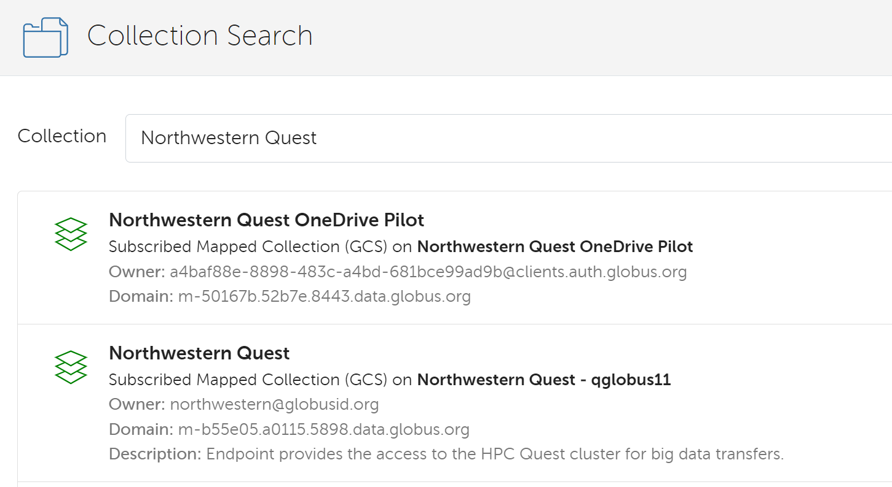
Selecting Destination of Transfer
To select a Collection to serve as the data destination, click in the Collection field.
This action will pull up the Collection Search page. You have the option of searching for a Collection by name or UUID.
You can type Northwestern Quest into the search bar or the UUID.
Several Collections will be listed with Northwestern Quest in the name, but you will want to select the Subscribed Mapped Collection (GCS) on Northwestern Quest – qglobus11

Slide 27
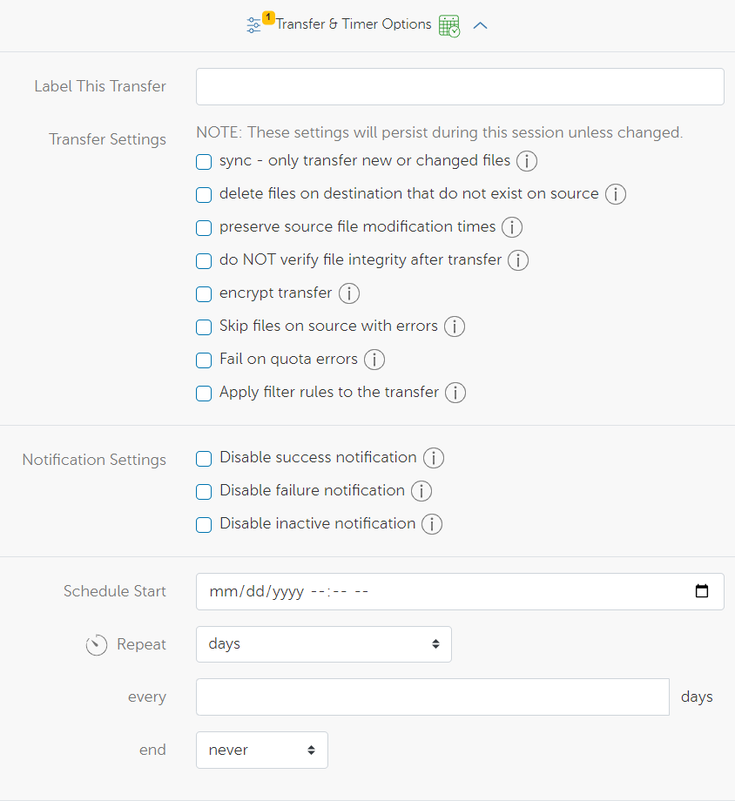
File Manager: Transfer & Timer Options

Slide 28
Recommended Transfer Options
Sync: Data in your files will only be transferred if it meets a selected criteria when comparing the source to the destination of the transfer. Criteria include:
Modification time is newer
File size is different
File does not exist on destination
File checksum is different
Preserve Source file modification times: The last modified date of the file that is copied will retain the date of the original file.
Encrypt Transfer: Data in your files will be encrypted while in transit. Both endpoints must support encryption to ensure a successful transfer.
Skip files on source with errors: Files on source with "file not found" and "permission denied" errors will be skipped rather than causing the entire transfer procedure to fail.

Slide 29
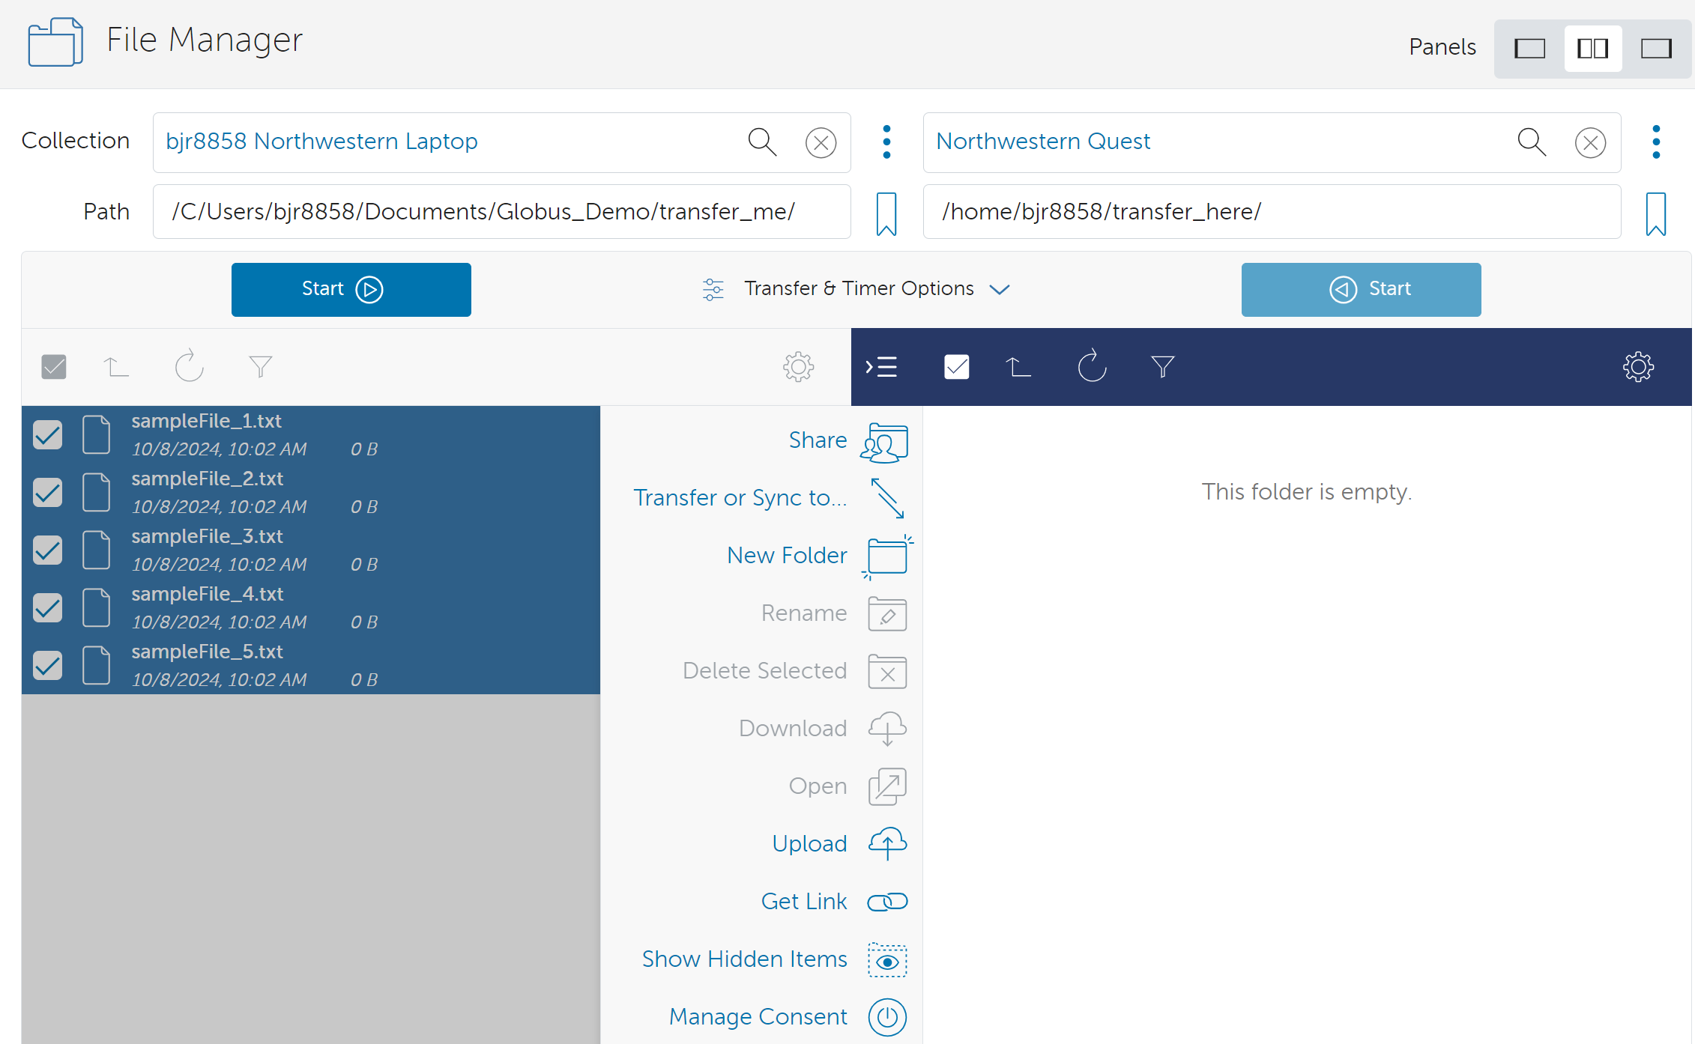
Submitting the Transfer

Slide 30
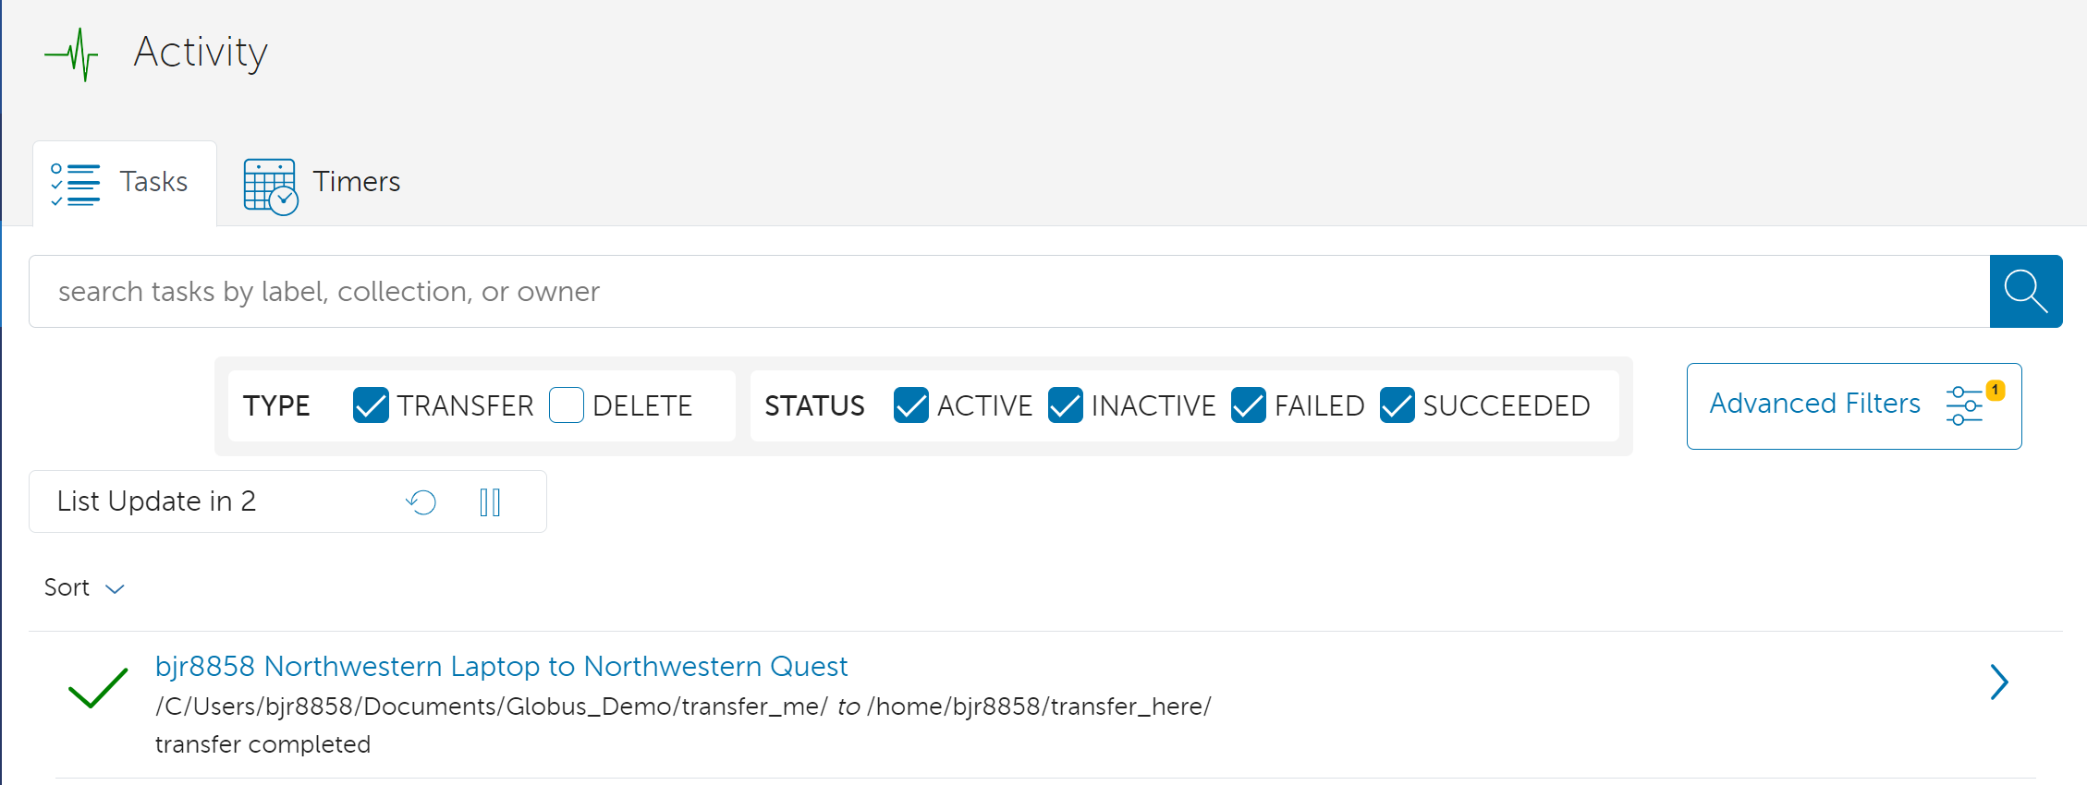
Monitoring Transfer Status

Slide 31
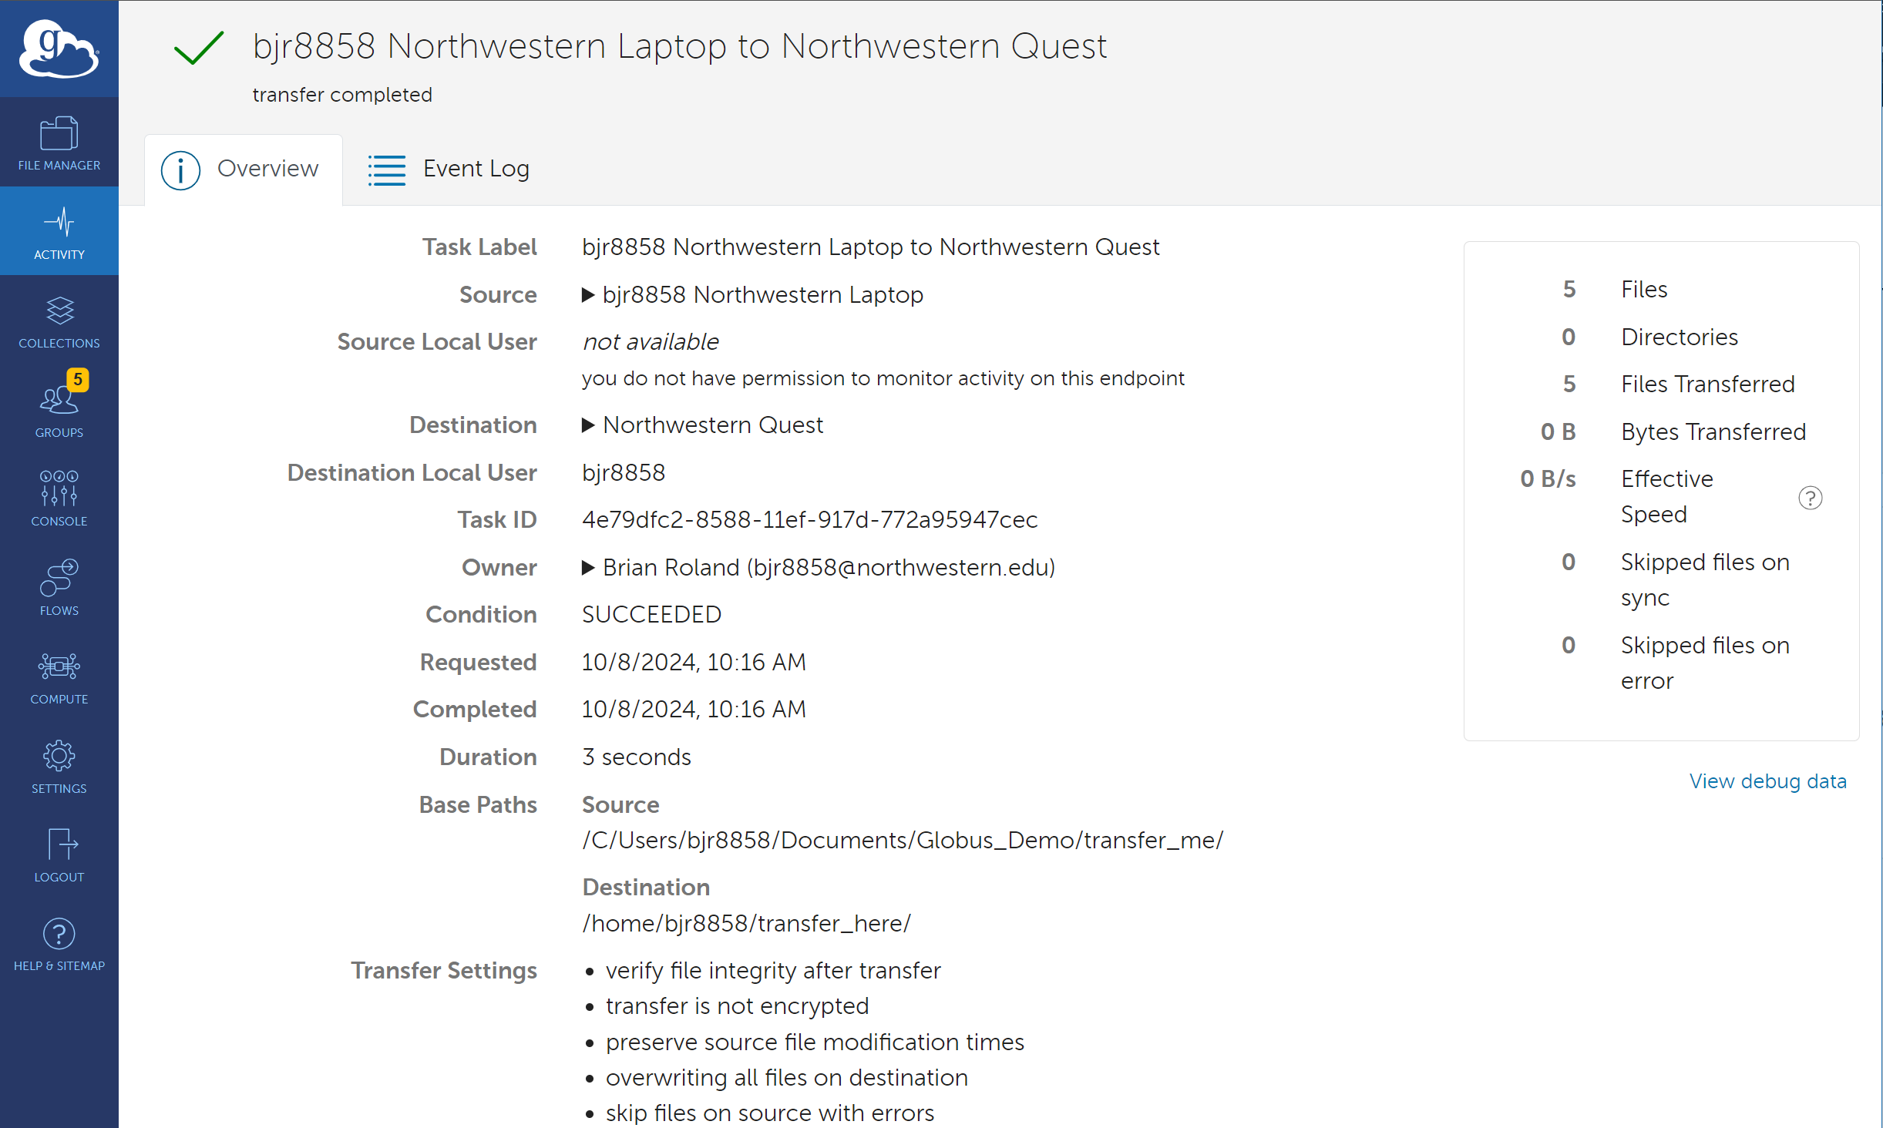
Monitoring Transfer Status: Overview

Slide 32
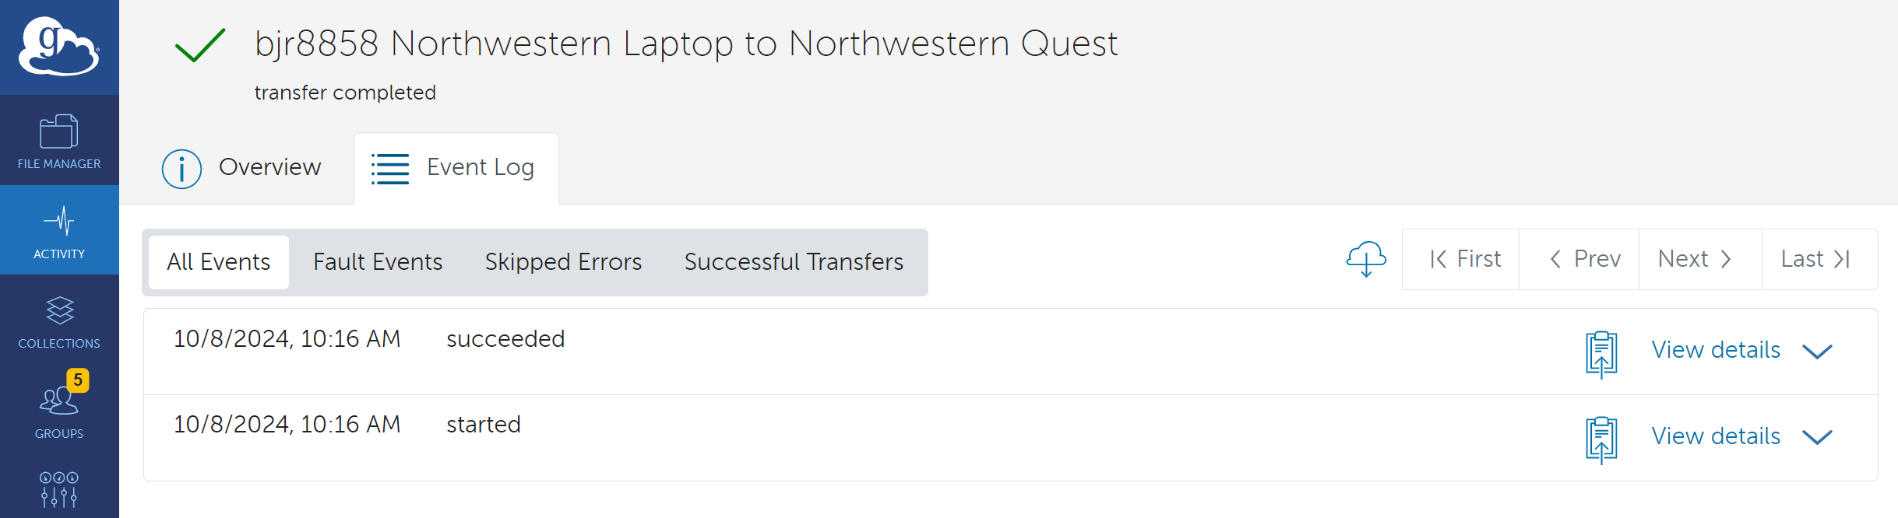
Monitoring Globus transfer status: Event Log

Slide 33
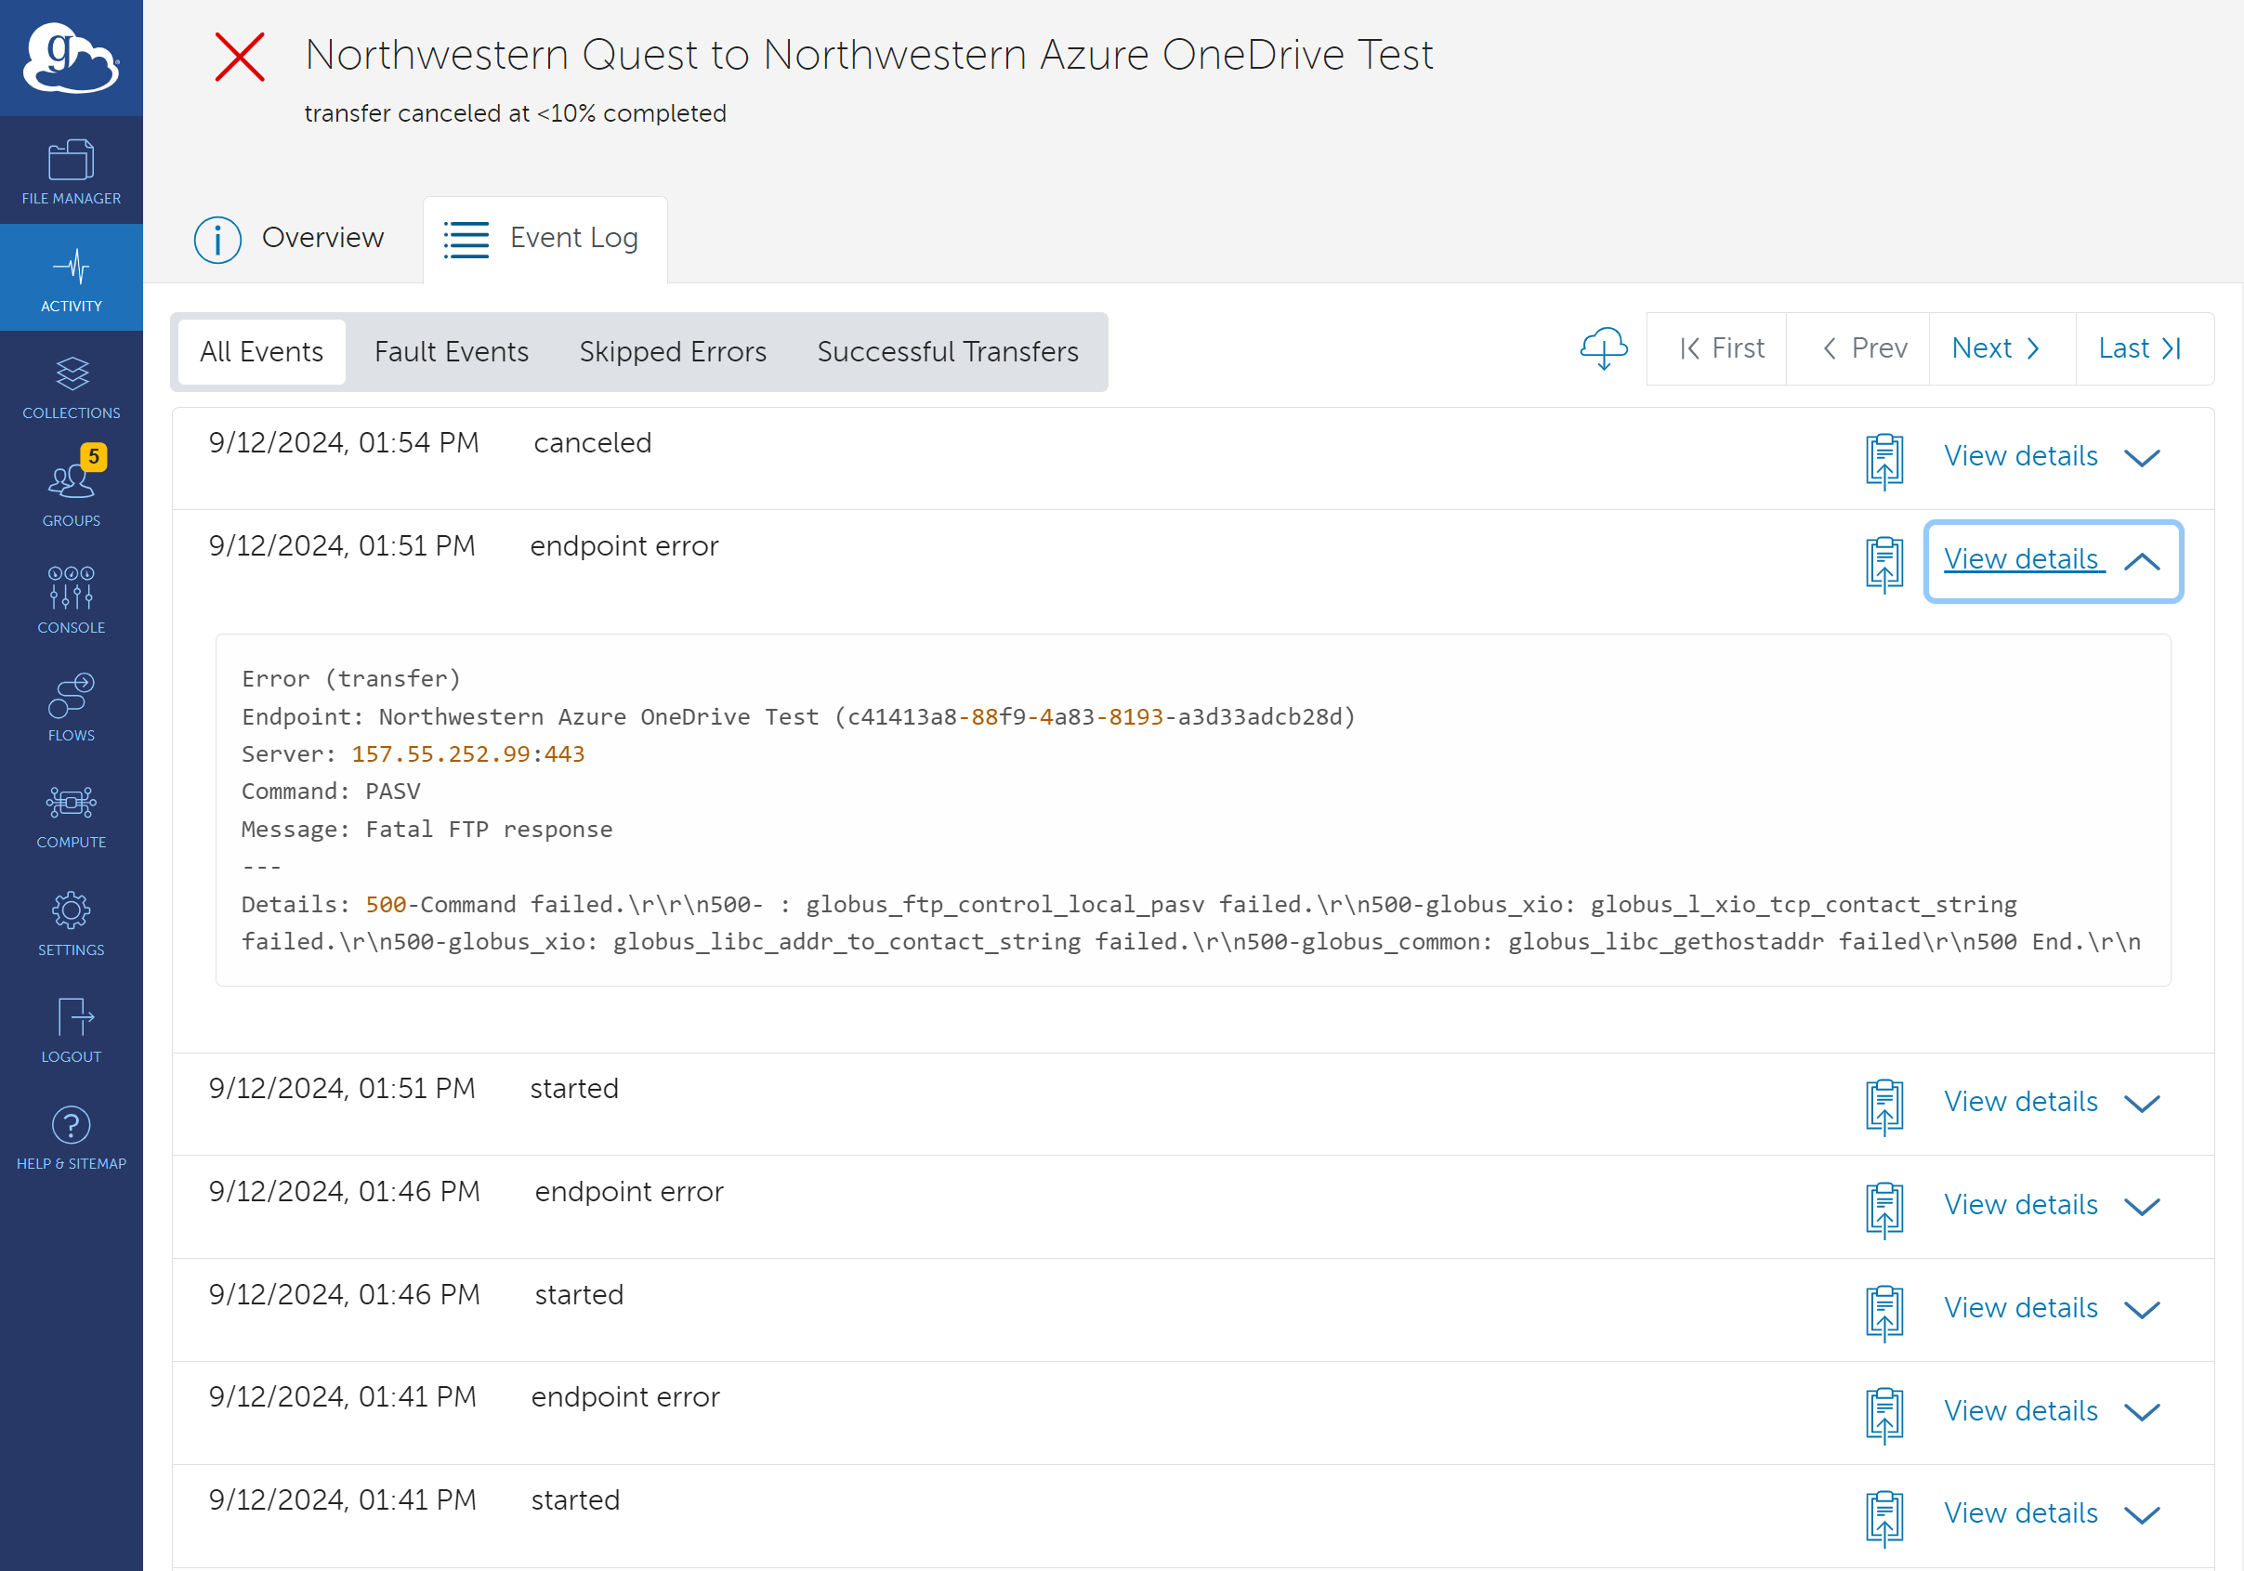
Event Log w/ Errors

Slide 34
Use Case #2
Scenario: Brian Roland must perform a weekly backup of Quest data to RDSS for long term data retention. While he could do this manually every week, he is interested in an automated option
Prerequisite: You must have contacted NU IT via the Request Access to RDSS via Globus form to get configured for Globus access to RDSS (resfiles, FSMResfiles)

Slide 35
Automating and Scheduling Globus Transfers
To setup a scheduled or recurring transfer, the user would start by following the same steps as a manual transfer by selecting a data source and destination. Next select the transfer settings.
To automate/schedule you would need to complete the additional Timer Options:
Label This Transfer: A descriptive field for the transfer that can help you identify the automated transfers in the Activity page (recommended)
Schedule Start: The date and time you want to schedule the automated transfer
Repeat: Define the unit of measurement for how often you want the scheduled transfer to repeat. Options are days, hours, and minutes
Every: Provide a numerical value to define the interval between recurring transfers based on the chosen unit of measurement
End: Define the end date that the recurring transfers should stop
Scheduled and repeating transfer tasks can be viewed in the Timers tab of the Activity page.

Slide 36
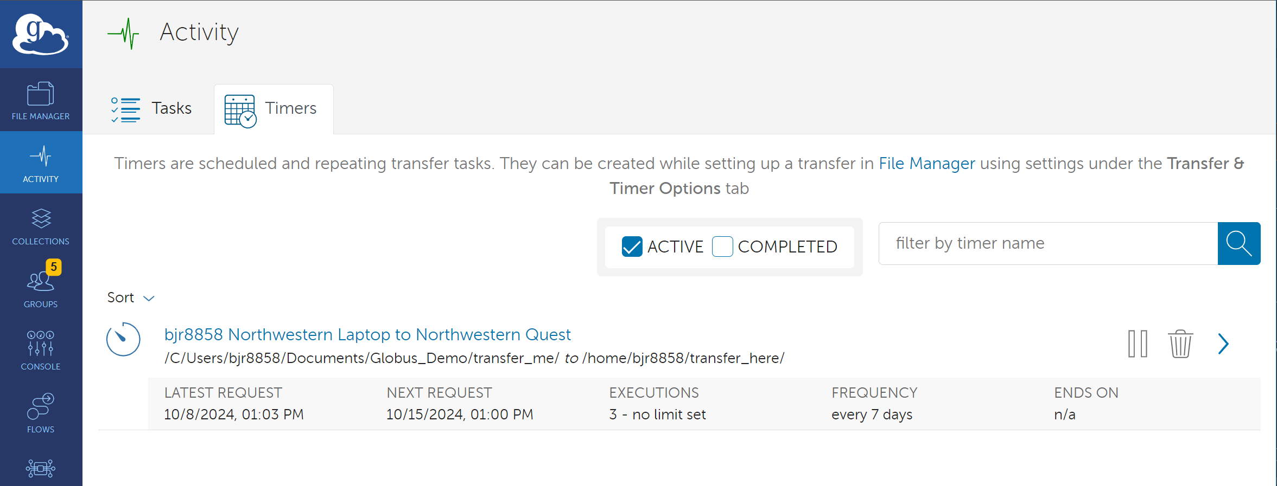
Activity: Timers

Slide 37
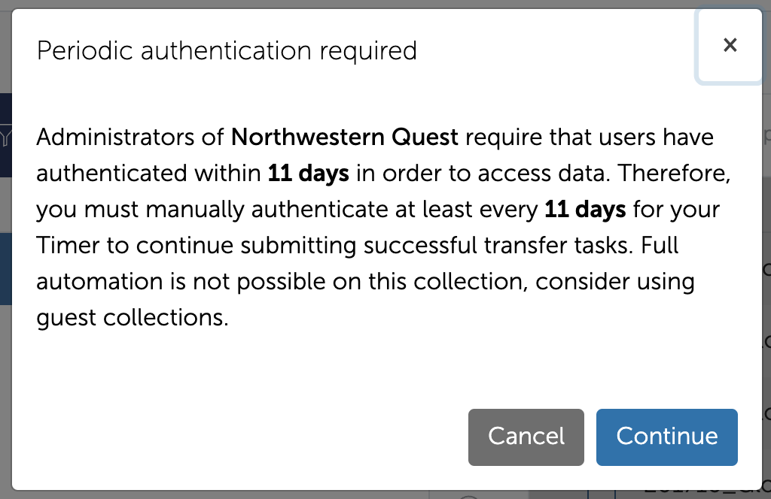
Periodic authentication required
It is important to note, that when you set up a recurring automated transfer with a NU IT managed Mapped Collection, that it requires you to authenticate with Globus at least every 11 days. If you do not authenticate, then the automated transfer will not continue.
For full automation without the need to authenticate Globus says to consider using a Guest Collection.
While a Guest Collection’s primary function is to aid in sharing data with collaborators, it also aids in automating access to data without the threat of a authentication timeout.

Slide 38
Use Case #3
Scenario: Brian Roland would like to share data with Professor X, a research collaborator that is doing genomics research. Professor X in being assisted by students in his lab. Brian would like to share a specific subset of data without giving Professor X and his students access to his entire Quest allocation.

Slide 39
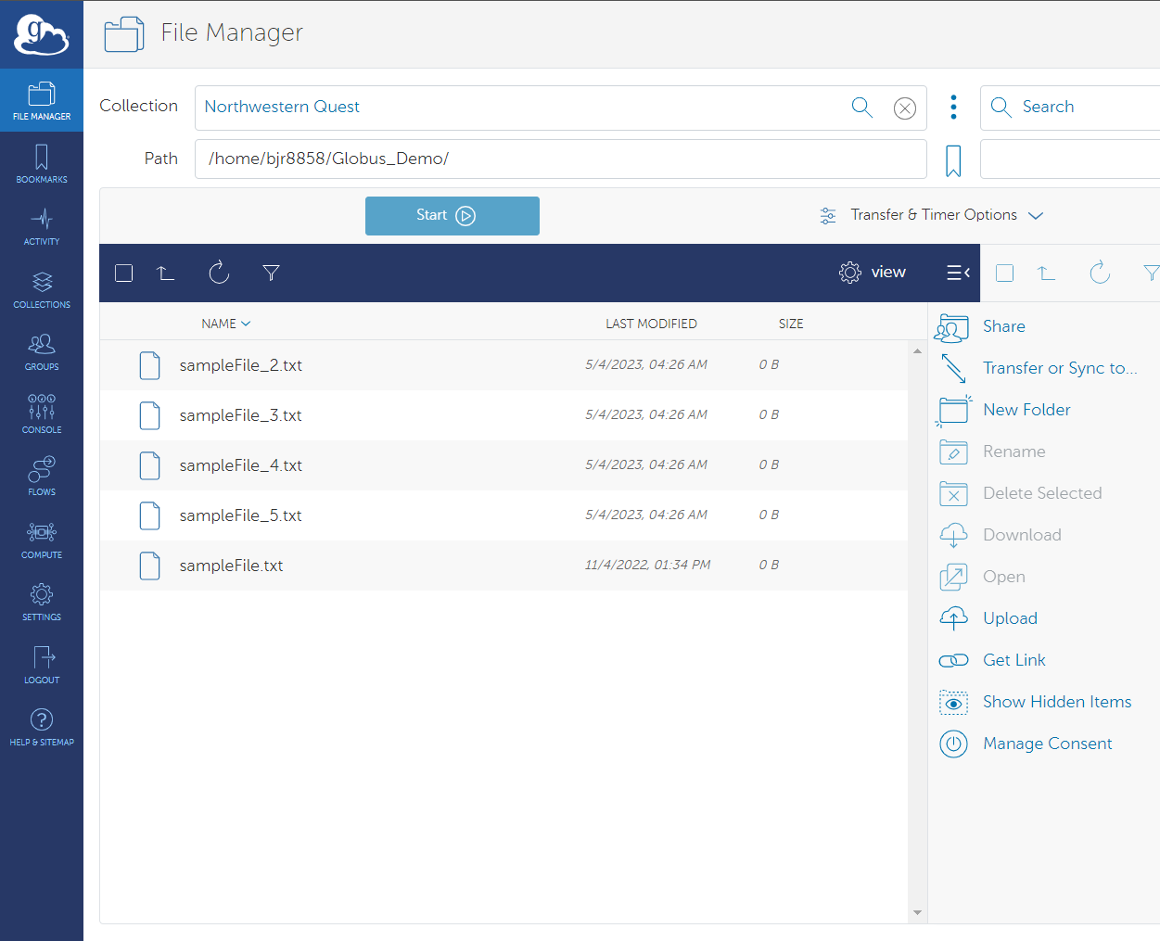
Data Sharing
To share data with Northwestern collaborators as well as external collaborators, users would leverage the Guest Collection functionality in Globus.
To setup a Guest Collection, navigate to the File Manager. In the Collection field, search for and select the Collection that the Guest Collection will be mapped to for access.
Once a Collection is selected and the Path is defined, the user should click on the Share link/icon to the right of the Collection
The Globus interface will next show a list of publicly listed Guest Collections. You will need to click on Add Guest Collection in the upper right-hand corner of the page

Slide 40
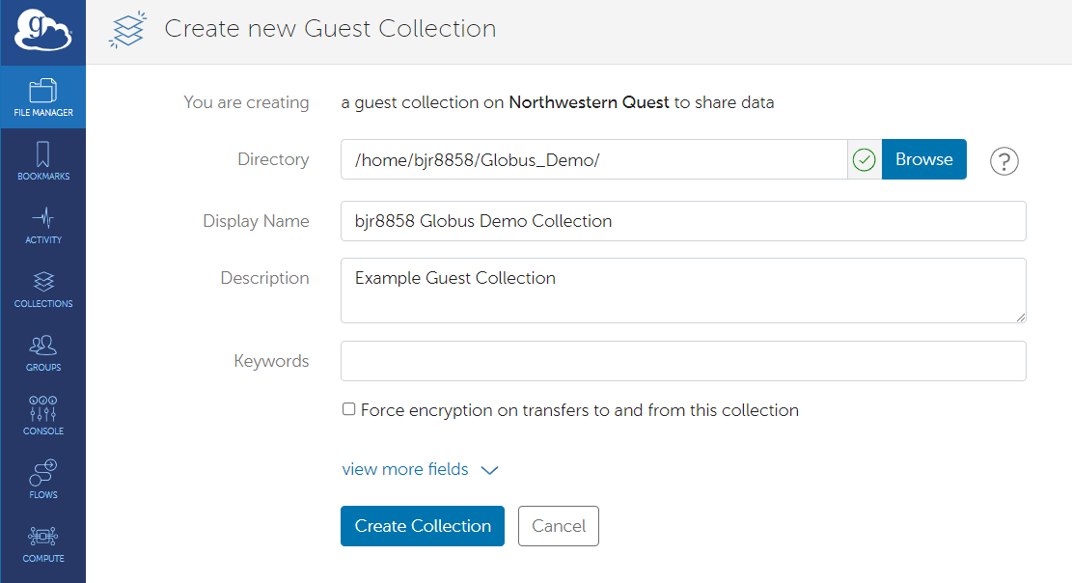
Data Sharing: Setup Guest Collection
The user will then be asked to define the root directory for the Guest Collection. This will be the highest-level directory that collaborators will have access to.
The user is also required to enter a display name for the Guest Collection. This name does not need to be Globally unique, but a unique name is recommended
Once you have defined the Directory and Display Name for the Guest Collection, you will be able to then create the Guest Collection by clicking the Create Collection button
You will then be shown Permissions information on the Guest Collection that was just created. To share this Collection with collaborators the user would next need to click on Add Permissions – Share With

Slide 41
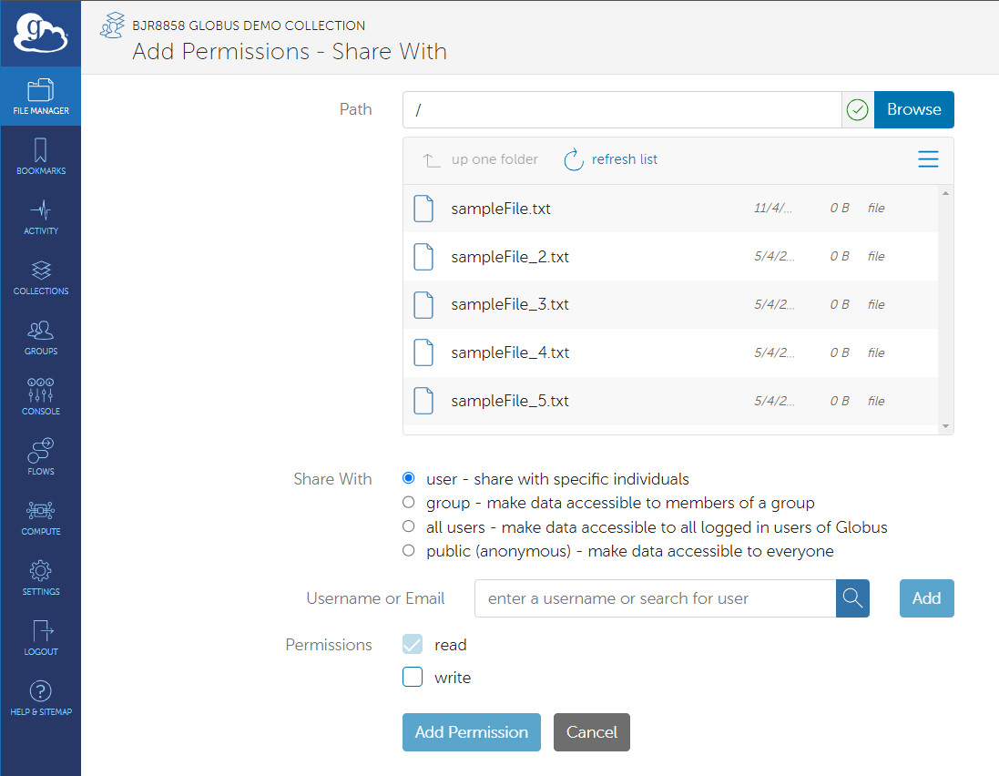
Data Sharing: Guest Collection Permissions
A new page will be displayed that will have a field to define the root on the Guest collection that external collaborators have access to. The interface will also display the files available in the path selected
Users will be able to select individual users or groups whom they want to share the path on the Guest Collection with.
Read and Write permissions can be assigned to the user or group that that should have access to the path indicated in the Path provided
By clicking Add Permission, users can add the user or group to having access

Slide 42
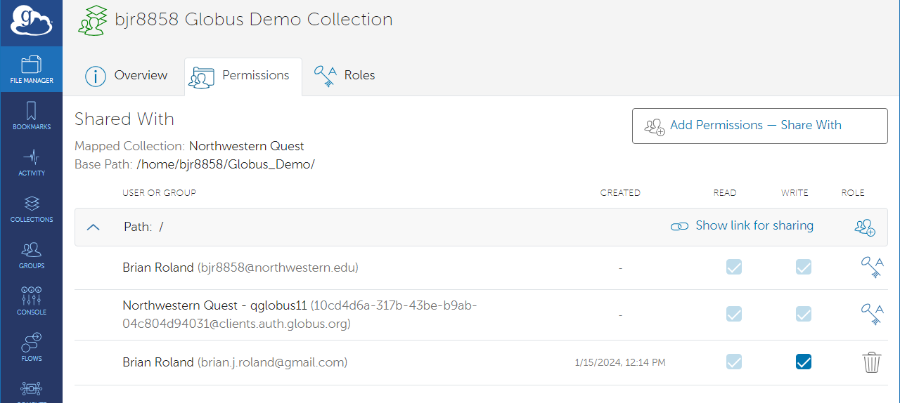
Data Sharing: Setup Guest Collection
Globus will return you to the Permissions page of the Guest Collection where it will list the users or groups who have access to the Guest Collection and the root path of each user’s access

Slide 43
Globus Groups
Globus Groups are collaborative spaces within the Globus platform that facilitate organized and secure teamwork.
Enable users to create groups, invite members, and manage access permissions for efficient data sharing.
Grant fine-grained control over who can access shared resources, ensuring data security and privacy.

Slide 44
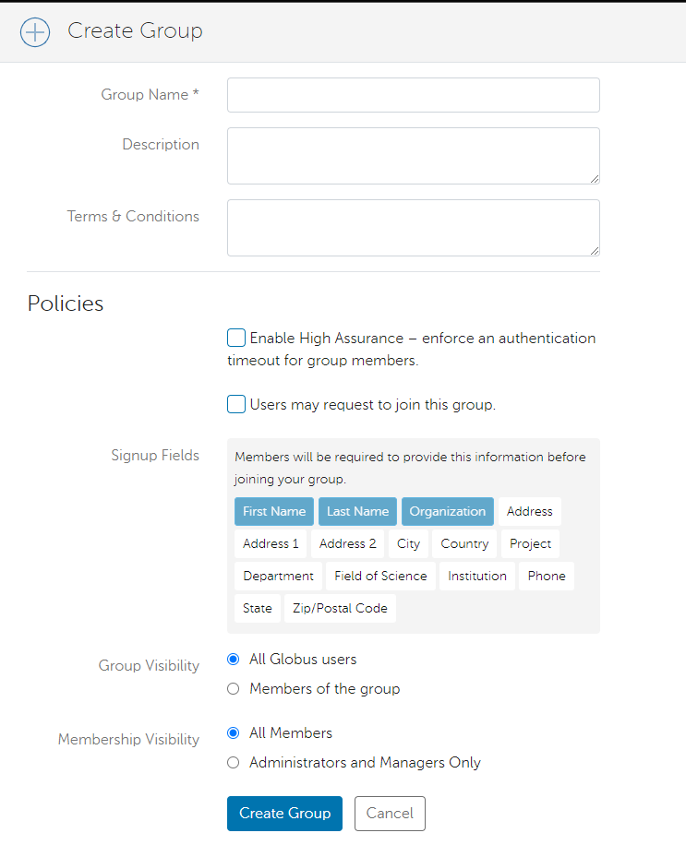
Create a Globus Group
To create a Globus Group to help manage user permissions, you will want to navigate to the Groups page in Globus and click Create new group in the upper right corner of the page
This action will take you to the Create Group page in Globus where you will need to define a Group Name.
You also have the option of providing a Description and Terms & Conditions of the group
Globus will also present you with optional Policies that you can choose to implement
Once you have defined these details, you would click Create Group to create the group

Slide 45
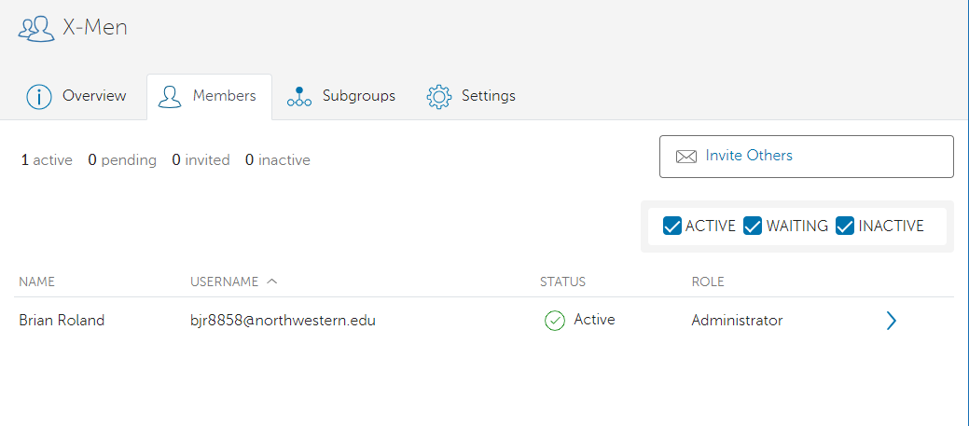
Manage Members of Globus Group
Once you create the group, you are taken to the group Overview page.
To manage members of the group, select the Members tab.
To invite users to the group, click Invite Others
You will next be prompted to enter the username or email of the user you want to invite to the group
After you enter the username or email address, you will then click Send Invitation to invite the member to join the group
You can either wait for the user to accept the invitation, or you can immediately make them an active member of the group by clicking their name in the Members section of the group and then click Add Membership
You can also remove users from the group by clicking their name and then click Remove Membership

Slide 46
Advanced Globus Features
Globus CLI
A command-line tool provided by Globus for interacting with the Globus service through the terminal.
Globus SDK
A collection of libraries, tools, and resources provided by Globus to simplify the development of applications and services that interact with the Globus platform.

Slide 47
Globus CLI
Globus provides the Globus CLI, a command line tool for interacting with the Globus service through the terminal.
The Globus CLI is an available module on Quest as part of software and applications commonly used on Quest
Available version: Globus-cli/3.5.0

Slide 48
Globus SDK
The Globus SDK is a collection of libraries, tools, and resources provided by Globus to simplify the development of applications and services that interact with the Globus platform
Offers pre-built functions and utilities for common tasks

Slide 49
Use of the Globus SDK
Registration:
Register your application with Globus.
Settings > Developers in the Globus web interface
Registration types are based on your application’s nature
Confidential Client: For server-to-server communication.
Public Client: For user-interactive applications.
Authentication:
Authenticate and obtain access tokens.
Functionality:
Use the SDK's functions.
Perform data management and transfer tasks.

Slide 50
Globus Resources
Globus Resources
NU KB Articles
Globus Documentation
Globus Connect Personal
How To Share Data Using Globus
How to configure firewall policy for Globus Connect Personal
Globus Command Line Interface (CLI) Reference
Using the Globus Data Transfer Tool
Using the RDS Globus Endpoint
Using Globus with Amazon S3 Object Storage
Using the OneDrive/SharePoint Globus Collection

Slide 51
Questions? globus-help@northwestern.edu

